Slide 1
LIF101 Lecture Topic (4)
05 January 2023
DNA as a genetic material
AND
Bacterial transformation and genetics
Introduction to bacteria
Frank Gregoria video
https://www.youtube.com/watch?v=qCn92mbWxd4

Slide 2
Bacterial transformation
That DNA is the genetic material was first discovered in bacteria and viruses. As it turned out, DNA is the genetic material in all living organisms ( except in case of RNA viruses).
Evidence of DNA as a genetic material came from a phenomenon observed in 1927, which was termed bacterial transformation (essentially meaning how a bacterial cell can genetically acquire new characteristics by a direct uptake of DNA from its surrounding). Discovery of bacterial transformation therefore becomes the first landmark of in the field of genetics of bacteria and viruses.
The process of exchange DNA is technically termed as DNA recombination. Thus, bacterial transformation is studied under the broad topic of “Recombination in bacteria” . There are more than one manner of exchanging DNA between two bacterial strains, apart from ‘ transformation’ . The two manner of genetic exchange between bacteria are “Conjugation” and “Transduction”. We will study all the three manner of bacterial DNA exchanges, briefly. These lessons can thus be termed as study of genetics of bacteria (as compared to the genetics of higher organisms we have studied so far).
However, you should also ask WHY should we study bacterial genetics? Is this useful at all?
Answers to this question will gradually unfold during the remain part of the course. For now, you can only note that entire field of “genetic engineering’ was based on bacterial and viral genetics. In fact bacterial and viral genetics is at the heart of what finally emerged as “Genetic engineering” .

Slide 3
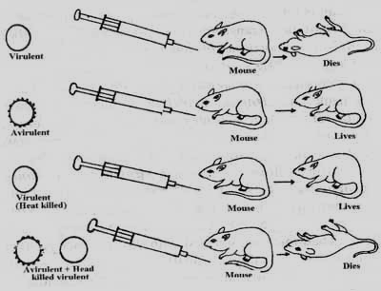
Griffith’s experiment 1927 : discovery of transforming factor (TF))
First historical demonstration of an chemical entity for genetic inheritance
What does this heat killing signify with respective genetic inheritance
Virulent strain kills the host
Non-virulent strain does not kill
Virulent
Dies
Heating kills virulent strain
Non-virulent
Lives
Virulent, heat killed
Lives
Heat-killed virulent strain can transfer its virulence “factor” to a non-virulent strain
Non-virulent + heat killed
Dies
Pneumococcal infection
Streptococcus pneumoniae
https://www.youtube.com/watch?v=0QjVnJ7H198&ab_channel=Don%27tMemorise

Slide 4
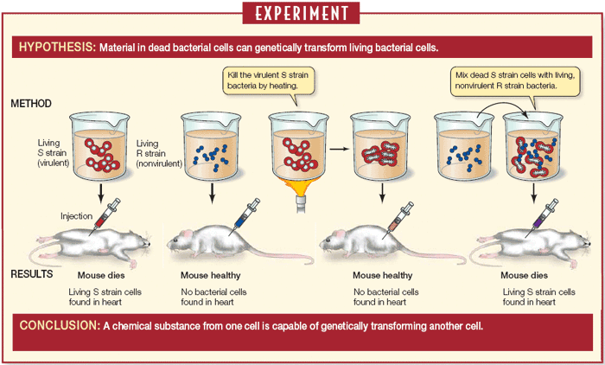
Further Visual Summary of Griffith's (1927) experiment on bacterial transformation
What did he discover??
Notes:
Griffith’s observations represent the first evidence of bacterial recombination by transformation, mean a direct uptake of DNA from the growth medium

Slide 5
What is genetic transformation?
Which one was genetically transformed?
The mouse or the bacteria?

Slide 6
Avery, MacLeod, McCarty (1944): discovery of DNA as a genetic material https://en.wikipedia.org/wiki/Avery%E2%80%93MacLeod%E2%80%93McCarty_experiment
Purified the transforming factor (TF) to investigate its properties.
Salient points:
  Treatment with protease did not destroy TF
  Treatment with RNase did not destroy TF
  Purified TF did not have sugars
Thus TF should be DNA
What about Mendelian alleles? Are these too transforming factors, Mendelian factors?
Do these terms transforming factors, Mendelian factors and DNA carry similar meaning ?
Supporting materials: Khan Academy video (the read transcript of this video)
https://www.khanacademy.org/sciencalso take e/biology/dna-as-the-genetic-material/dna-discovery-and-structure/v/hershey-and-chase-conclusively-show-dna-genetic-material

Slide 7
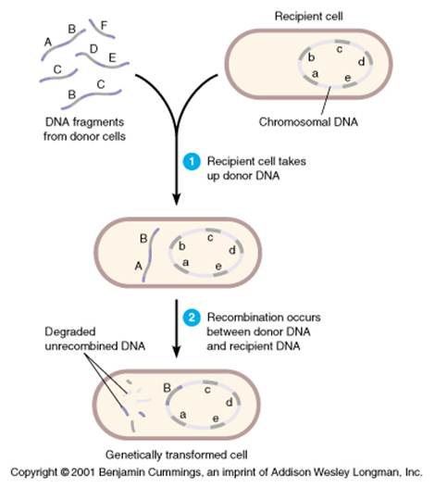
WHY bacterial transformation is also called bacterial recombination?

Slide 8
Bacteriophages – viruses that infect bacteria
  Consist of a protein capsid
  And a core of DNA (or RNA)
  Experiments used radioactive sulfur to tag the protein
  And radioactive phosphorous to tag the DNA
  The goal was to see which substance (protein or DNA) moved into the infected cell

Slide 9
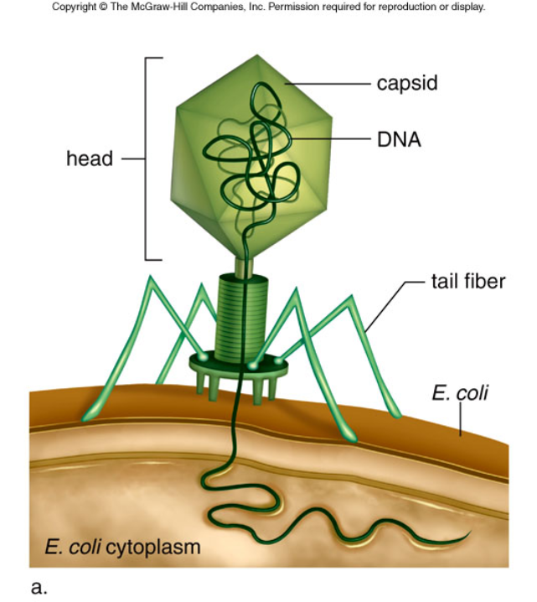
https://www.youtube.com/watch?v=U7Z5b8sITT0&ab_channel=Don%27tMemorise
Hershey and Chase experiment

Slide 10
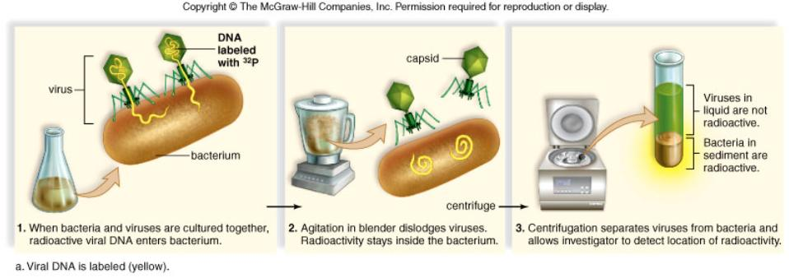
Conclusion:
The radioactive tag on the DNA went into the bacteria

Slide 11
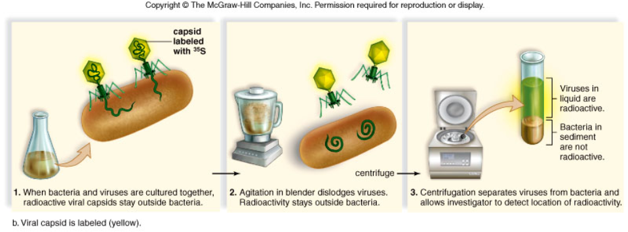
Conclusion:
The radioactive tag on the protein did not go into the bacteria

Slide 12
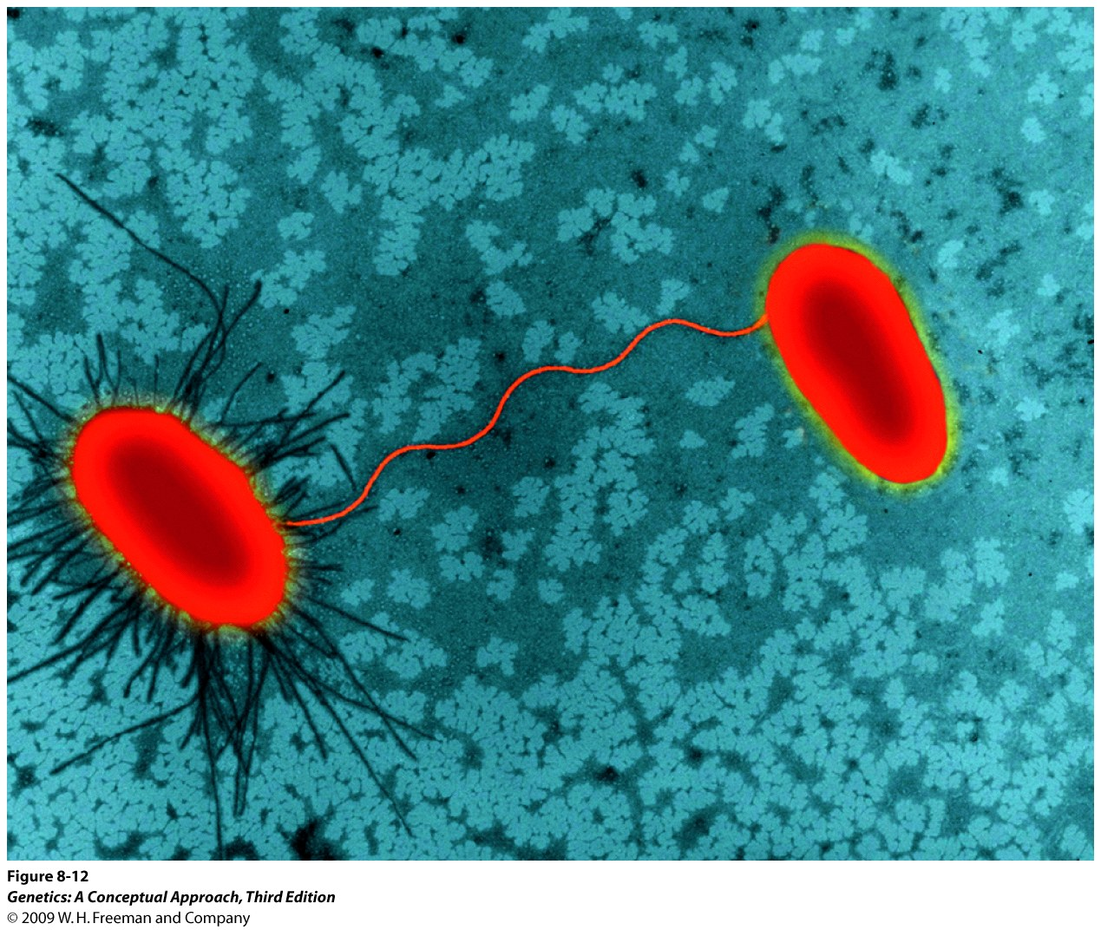
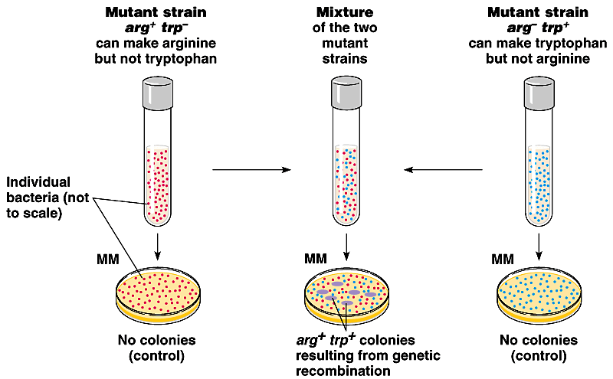
Gene Transfer in Bacteria: Conjugation
Direct transfer via connection tube, one-way traffic from donor cells to recipient cells.
It is not a reciprocal exchange of genetic information.
F⁺ cells donor cells containing F factor
F⁻ cells recipient cells lacking F factor
Sex Pilus – connection tube

Slide 13
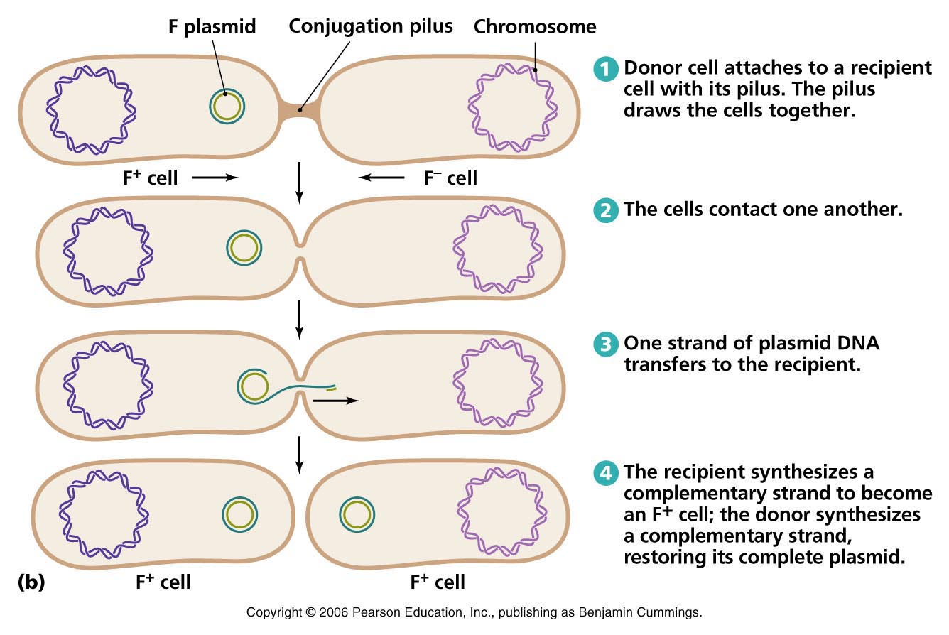
Explanation for conjugation
F factor are extra chromosomal and self replicating circular DNA that carry antibiotic resistance gene

Slide 14
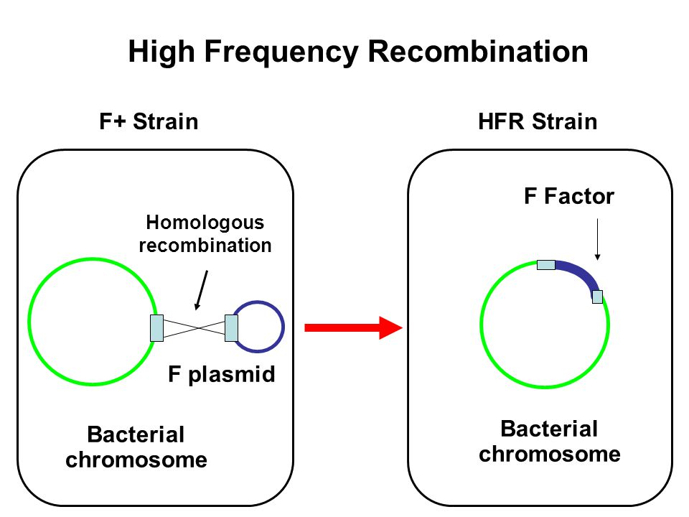
Some bacterial strain become highly efficient in transferring their genes:
these are called high frequency recombination (Hfr) strains

Slide 15
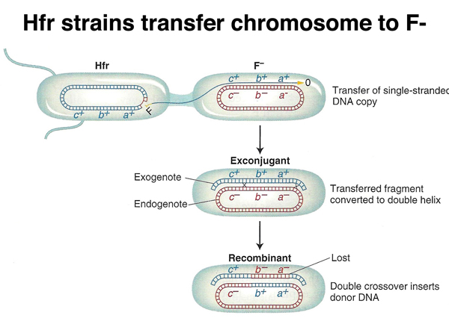
When the direction of transfer is :
…….d—c—b—a→
which gene will seen in highest number recombinant if conjugation is disrupted at various point of time?

Slide 16
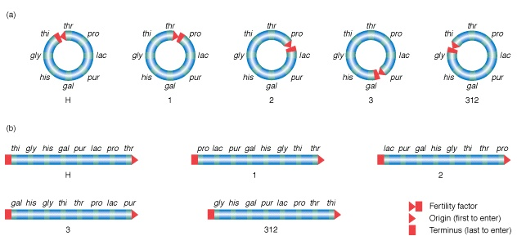
A surprise observation in the order of genes in different Hfr strains
How could gene order be different in different strains of the same bacterial species?

Slide 17
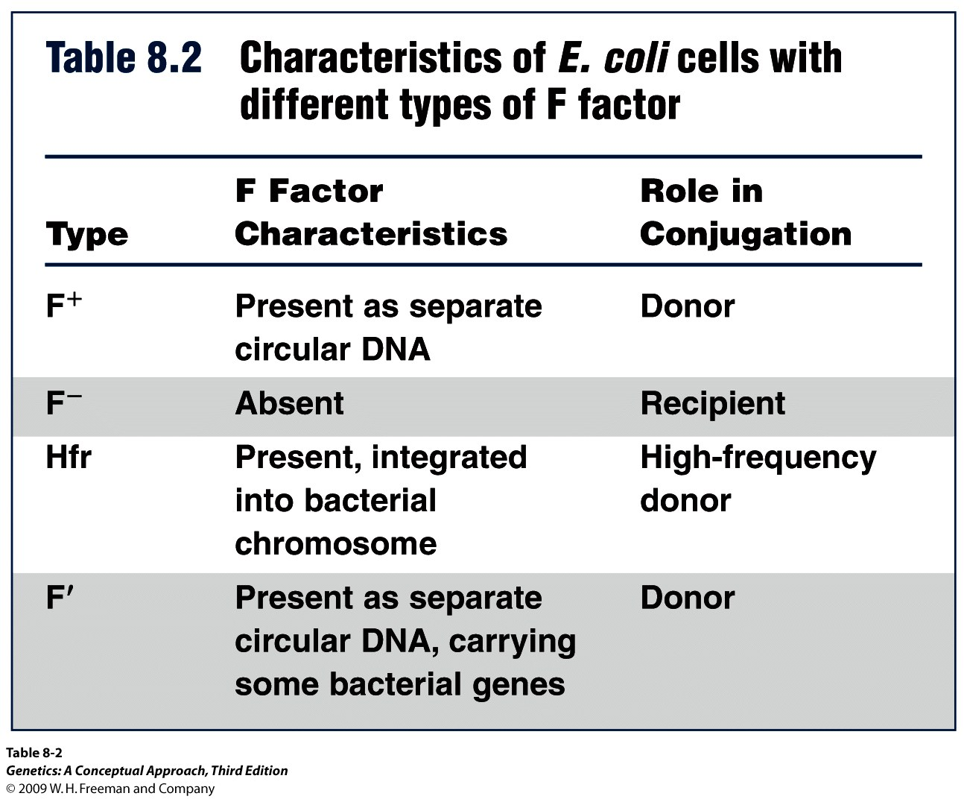
Conjugation:
    Hfr cells: (high-frequency strains) – donor cells with F factor integrated into the donor bacterial chromosome
    F prime (F′) cells: contain F plasmid carrying some bacterial genes
    Merozygotes: partial diploid bacterial cells containing F plasmid carrying some bacterial genes

Slide 18
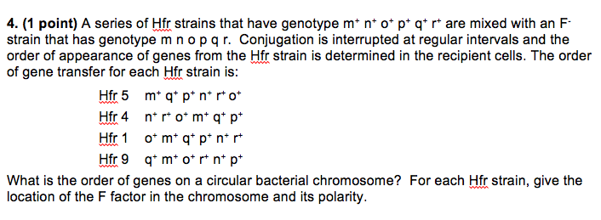
Problem

Slide 19
End to today's lecture

Slide 20
Transduction : bacteriophage (virus) mediated bacterial recombination
New Topic for the next class
(you can read this content in advance)

Slide 21
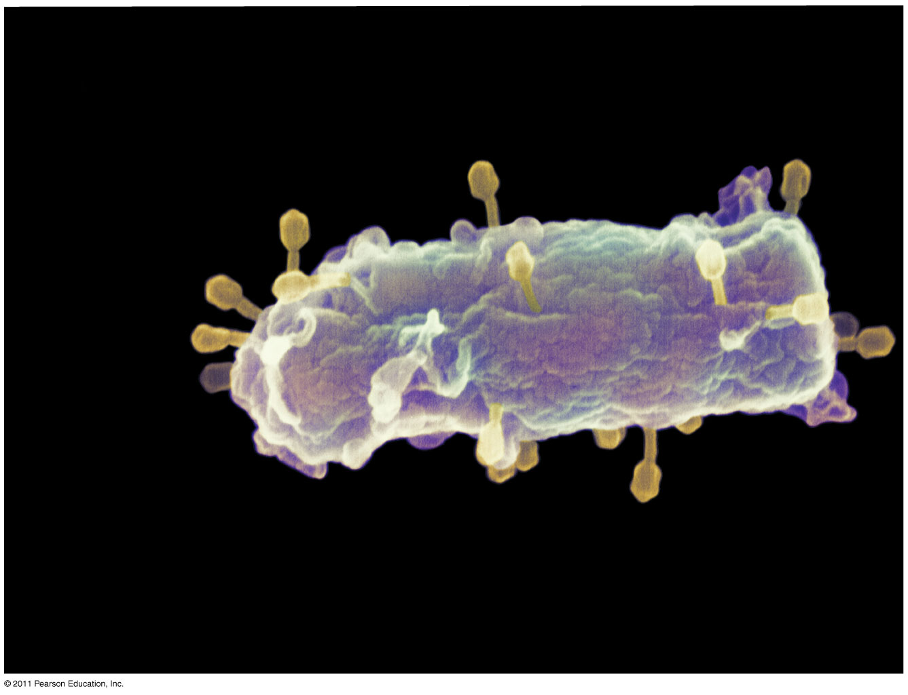
Overview: A Borrowed Life
Viruses called bacteriophages can infect and set in motion a genetic takeover of bacteria, such as Escherichia coli
Viruses lead “a kind of borrowed life” between life-forms and chemicals
A virus consists of a nucleic acid surrounded by a protein coat. Viruses were detected indirectly long before they were actually seen

Slide 22
Structure of Viruses and their genome
Viruses are not cells
A virus is a very small infectious particle consisting of nucleic acid enclosed in a protein coat and, in some cases, a membranous envelope
Viral genomes may consist of either
  Double- or single-stranded DNA, or
  Double- or single-stranded RNA
Depending on its type of nucleic acid, a virus is called a DNA virus or an RNA virus

Slide 23
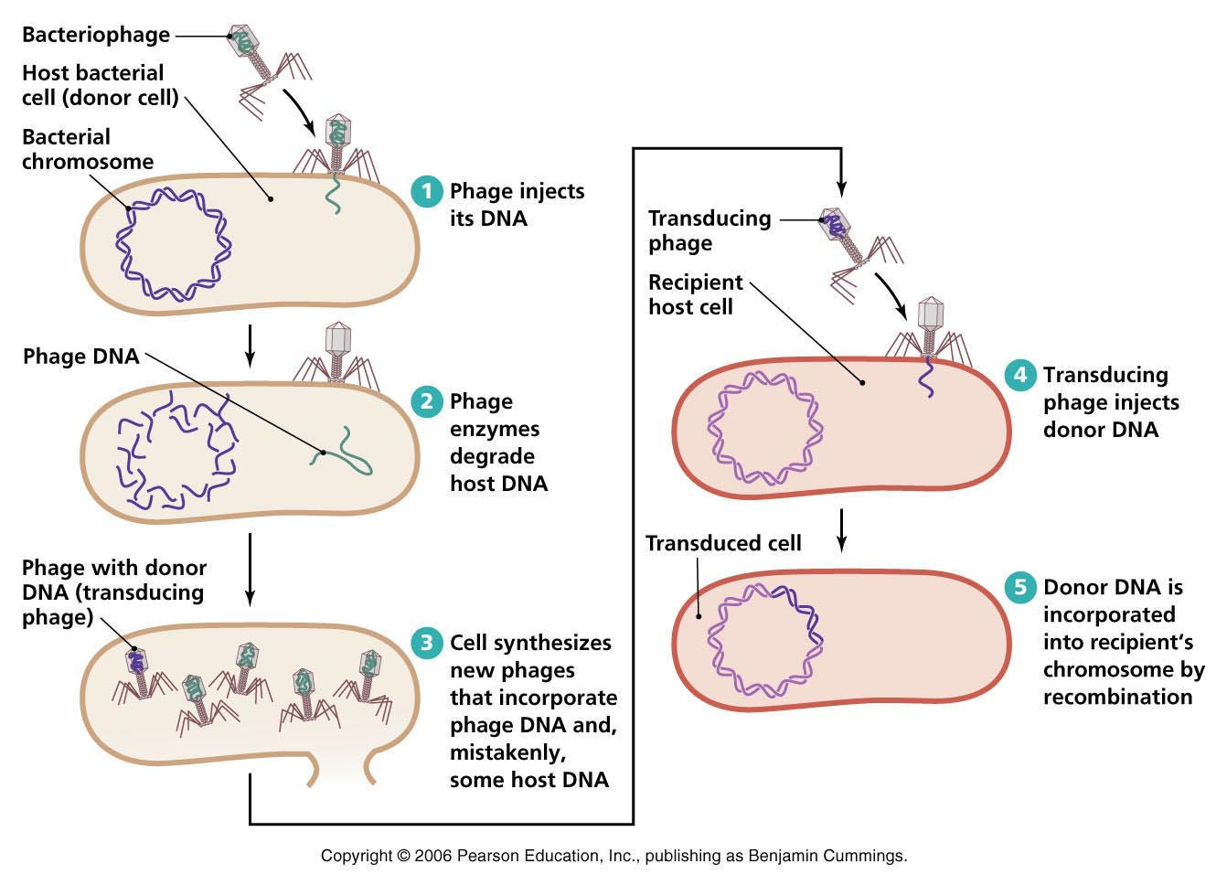
Bacteriopphage (1920s) : from bacterium + Greek phagein ‘eat’.

Slide 24
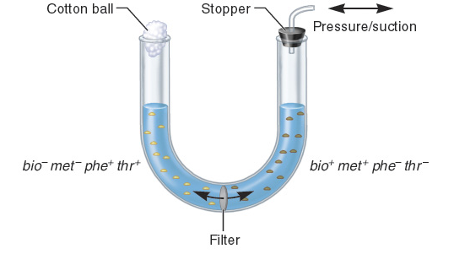
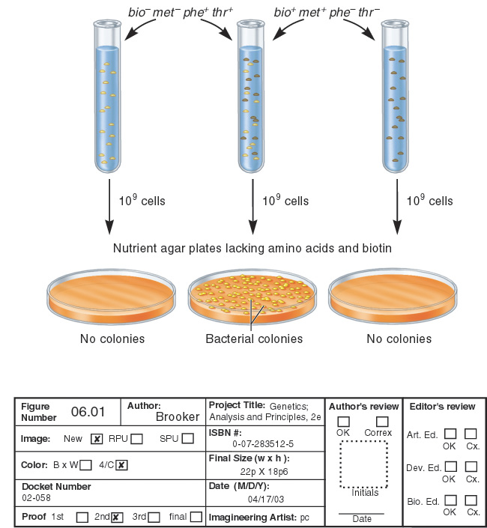
How was generalized transduction discovered?
LA-22
LA-2
phe– trp– met⁺ his⁺
phe⁺ trp⁺ met– his–
Nutrient agar plates lacking the four amino acids
Colonies
No colonies
Genotypes of surviving bacteria must be phe⁺ trp⁺ met⁺ his⁺

Slide 25
Watch these youtube video
Generalized transduction
https://www.youtube.com/watch?v=C44ymgwgA-o

Slide 26
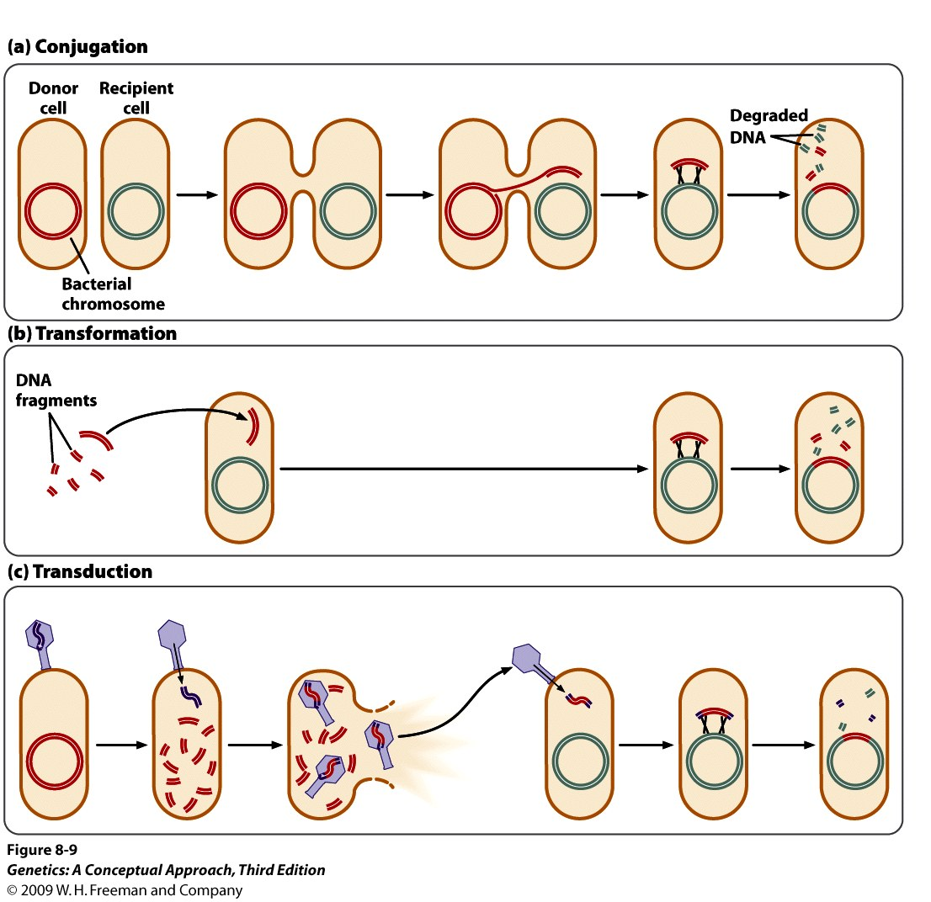
Three modes of genetic recombination in bacteria
We will cover this part
today
Notes:
Conjugation, transformation, and transduction are three processes of gene transfer in bacteria. For the transferred DNA to be stably inherited, all three processes require the transferred DNA to undergo recombination with the bacterial chromosome.

